Slide 1
What Is An Information Security Program ?
Project definition:
A project has a defined start and end point and specific objectives that, when attained, signify completion
pmtips.net/blog-new/difference-projects-programmes

Slide 2
What Is An Information Security Program ?
Program definition:
A program is defined as a group of related projects managed in a coordinated way to obtain benefits not available from managing the projects individually
pmtips.net/blog-new/difference-projects-programmes

Slide 3
What Is An Information Security Program ?
Security program:
Sum-total of all activities planned and executed by the organization to meet its security objectives
pmtips.net/blog-new/difference-projects-programmes

Slide 4
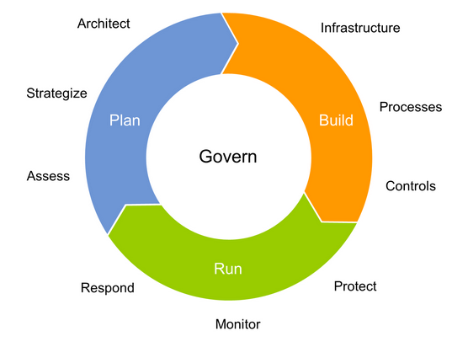
What Is An Information Security Program ?
https://www.gartner.com/doc/2708617/information-security-program-management-key

Slide 5
What Is An Information Security Program ?
1. Policy
2. Management commitment & performance review
3. Risk management
4. Asset management
5. Access control
6. Physical & environmental
7. Operations security
8. Communications security
9. Incident management
10. Business continuity
11. Compliance
12. Third-party reviews
ISO27001:2013 (ISMS) REQUIREMENTS
AND CONTROLS

Slide 6
What Is An Information Security Program ?
4 Layer Security
Transformation Model
4. Security Governance
3. Security Engineering
2. Vulnerability Management
1. Security Hardening

Slide 7
What Is An Information Security Program ?
4-layer security transformation model may be implemented as an ideal security program
After establishing a basic policy, the sequence of the program (steps 1 through 4) is paramount in order to achieve constructive results

